Slide 1
Bank Churn prediction
Mentor : Sriraman Sir
Name : Kushal Singh Ramgadiya

Slide 2
OUTLINE
Project Introduction/ Problem Statement
Describe the dataset
Describe the Treatment of Data
Different Algorithms
Cross – Validation results
Comparison chart
Conclusion

Slide 3
PROJECT INTRODUCTION
One of the greatest challenges faced by service companies is to retain its customers. More customers means more business and revenue to the company.
The cost involved in targeting new customers is a lot more than the effort to retain the existing ones.
Keeping this in mind, companies (that also includes banks) try to get some insights into the customer data to identify those customers who are likely to leave (churn).

Slide 4
PROBLEM STATEMENT
Build a predictive model to determine which customers are likely to churn (leave the bank)
Given a set of customer record, determine the probabilities of churn for each customer

Slide 5
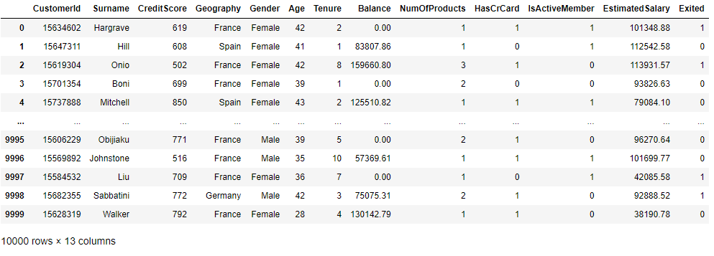
DESCRIBE THE DATASET
The Customer churn dataset is of a bank that contains 10000 records in a CSV format.

Slide 6
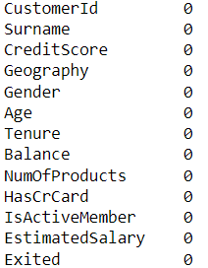
DATA PREPROCESSING
In given dataset, there is no null value and duplicate.

Slide 7
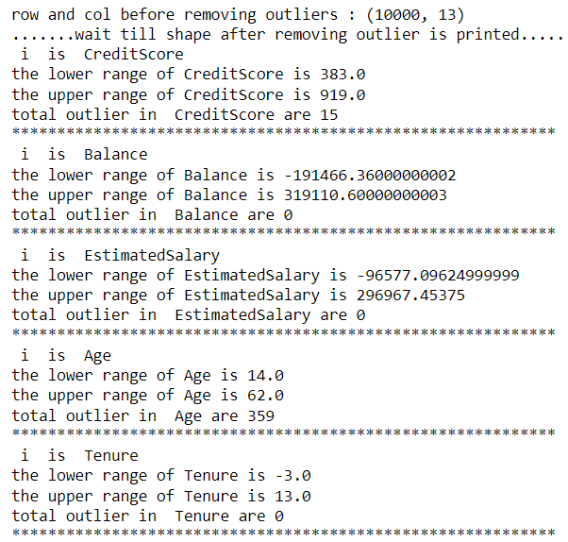
Outlier treatment
There are few outliers in Credit Score and Age.
Credit scores ranging from 300 to 579, 580 to 669, 670 to 739, 740 to 799, and 800 to 850 are considered to be very poor, fair, good, very good, and excellent.

Slide 8
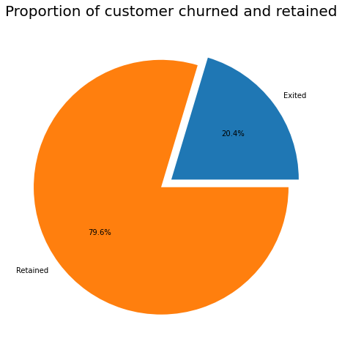
EXPLORATORY DATA ANALYSIS ( UNIVARIATE )
From this pie chart we can see the composition of the customers .
79% of the customers are staying and 20% are leaving.

Slide 9
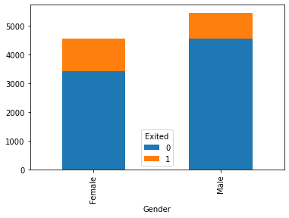
From the output, it seems that the ratio of customers leaving the bank among females is higher than the males. Let’s verify this. Execute the following script.

Slide 10
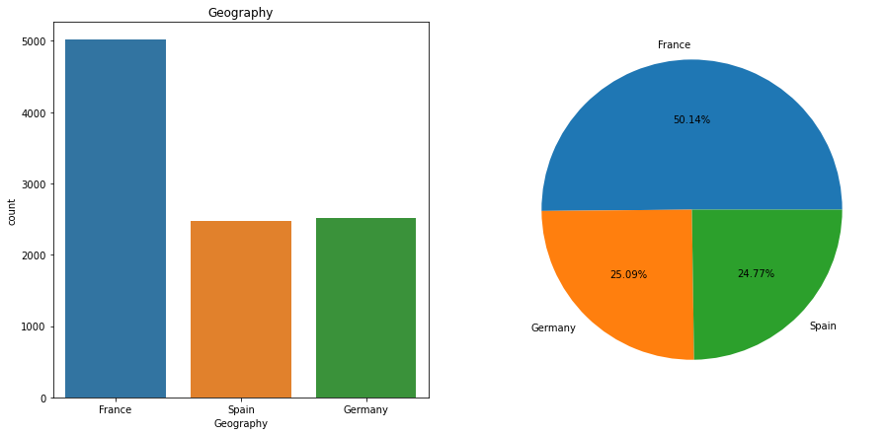
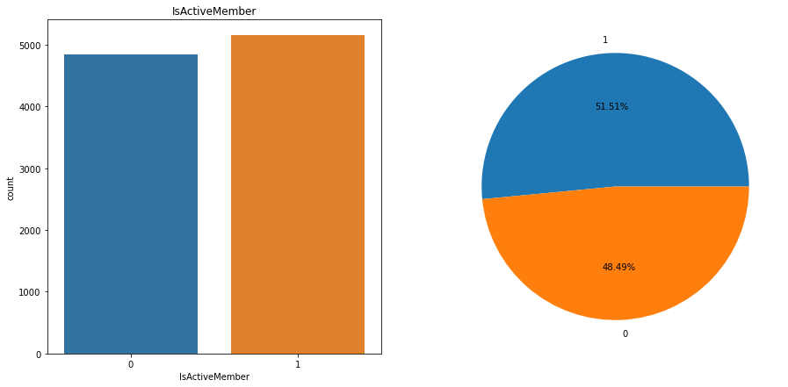
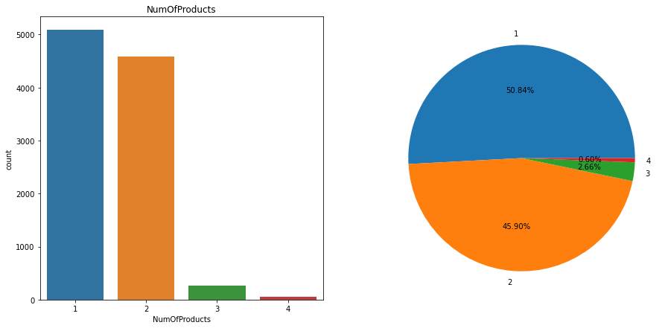
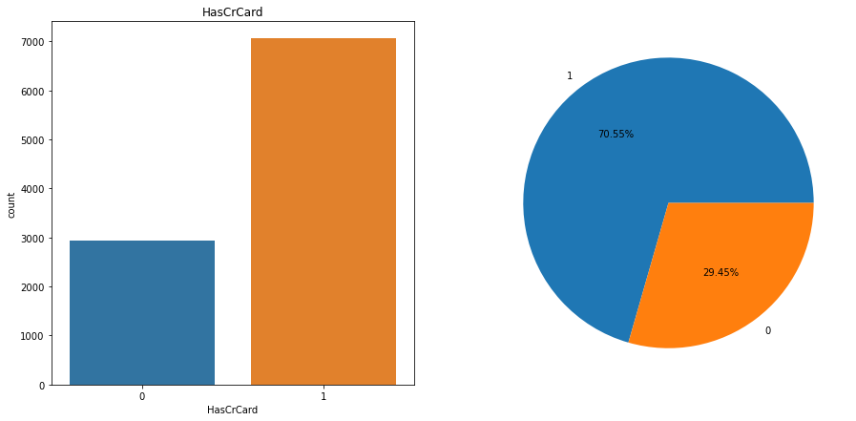

Slide 11
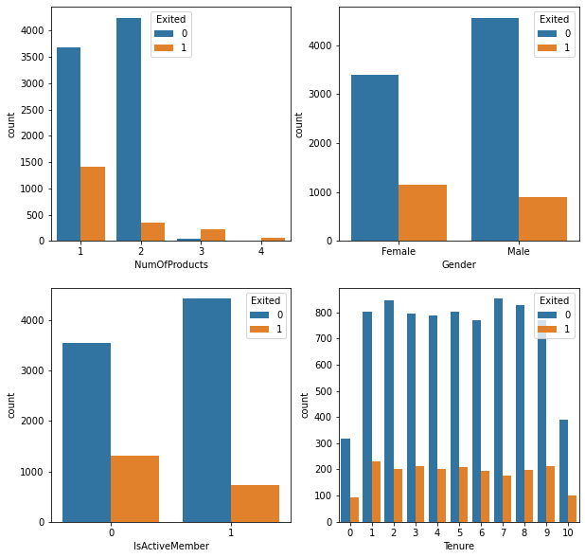
Bivariate

Slide 12
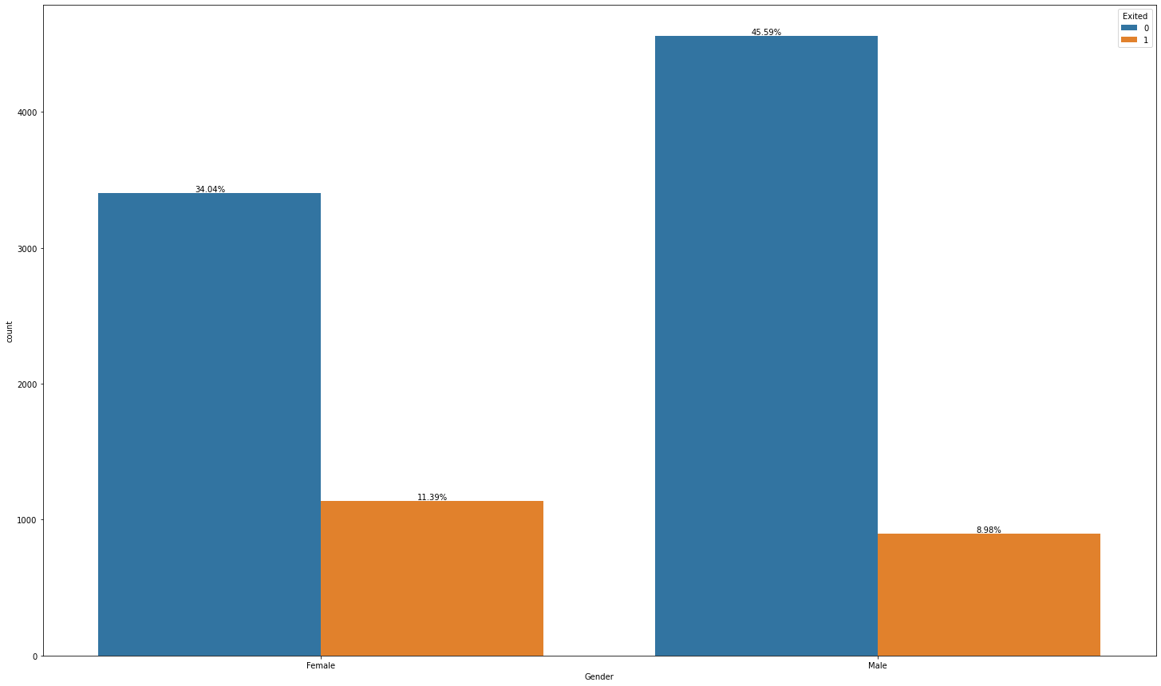
Inactive customers are leaving more as compared to active customers.

Slide 13
Dividing Data into Training and Test Sets
After pre-processing, now we need to divide our data into training and test sets.
The machine learning algorithms will be trained on the training set and will be evaluated on the test sets.
But before that, we need to divide our data into labels and feature set.
In the feature set, we have all the columns except the “Exited” since the values in the “Exited” column are to be predicted.
On the other hand, the label set will only contain the “Exited” column.
Then we will divide our data into training and test set. Our test will consist of 20% of the total dataset.

Slide 14
BUILDING models
We divided our data into training and test set. Now is the time to create machine learning models and evaluate the performance.
We will use the five most commonly used machine learning algorithms:
Logistic Regression
KNN
Decision Tree
Random Forest
SVM
to train our models.

Slide 15
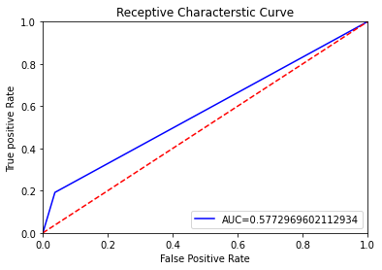
Logistic Regression
The logistic regression model achieves an accuracy score = 0.804 .

Slide 16
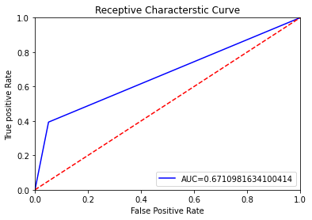
KNN
The KNN model achieves an accuracy score = 0.8345 .

Slide 17
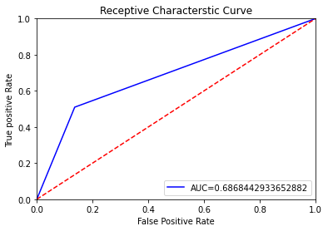
Decision Tree Classifier
The Decision Tree Classifier model achieves an accuracy score = 0.791

Slide 18
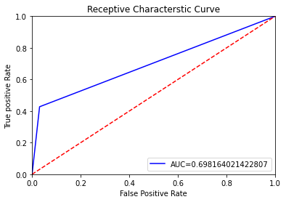
Random forest
The Random Forest model achieves an accuracy score = 0.857

Slide 19
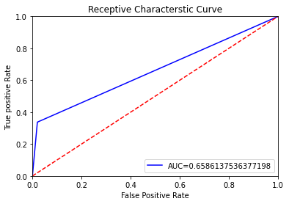
Support Vector Machine
The SVM model achieves an accuracy score = 0.847

Slide 20
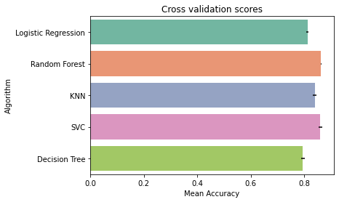
cross validation

Slide 21
CONCLUSION
We have created five models and the result showed that the Random Forest algorithm performs best with an accuracy of 85.7%

